Slide 1
Artificial Intelligence
Unit 2 (Part 2)

Slide 2
Heuristic Functions
Heuristic means finding solution to a problem quickly and efficiently.
The 8-puzzle was one of the earliest heuristic search problems. As mentioned earlier, the object of the puzzle is to slide the tiles horizontally or vertically into the empty space until the configuration matches the goal configuration.
The average solution cost for a randomly generated 8-puzzle instance is about 22 steps. The branching factor is about 3. (When the empty tile is in the middle, four moves are possible; when it is in a corner, two; and when it is along an edge, three.) This means that an exhaustive tree search to depth 22 would look at about 3**22 ≈ 3.1 × 10**10 states.
If we want to find the shortest solutions, we need a heuristic function.

Slide 3
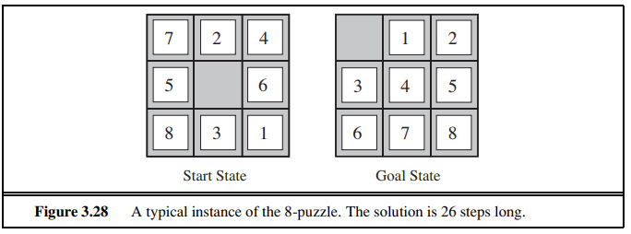
Heuristic Function:
h(n) = h1(n) + h2(n)
Where,
h1(n) = the number of misplaced tiles.
h2 (n) = the sum of the distances of the tiles from their goal positions.

Slide 4
h1(n) = Here, all of the eight tiles are out of position, so the start state would have h1(n) = 8.
h2(n) = 3 + 1 + 2 + 2 + 2 + 3 + 3 + 2 = 18.
h(n) = 8 +18 = 26.
It is easy to see from the definitions of the two heuristics that, for any node n, h2(n) ≥ h1(n).

Slide 5
Generating admissible heuristics from relaxed problems
If the rules of the puzzle were changed so that a tile could move anywhere instead of just to the adjacent empty square, then h1(n) would give the exact number of steps in the shortest solution.
Similarly, if a tile could move one square in any direction, even onto an occupied square, then h2 would give the exact number of steps in the shortest solution.
A problem with fewer restrictions on the actions is called a relaxed problem.

Slide 6
If a problem definition is written down in a formal language, it is possible to construct relaxed problems automatically.
For example, if the 8-puzzle actions are described as:
A tile can move from square A to square B if A is horizontally or vertically adjacent to B and B is blank,
we can generate three relaxed problems by removing one or both of the conditions:
(a) A tile can move from square A to square B if A is adjacent to B.
(b) A tile can move from square A to square B if B is blank.
(c) A tile can move from square A to square B.

Slide 7
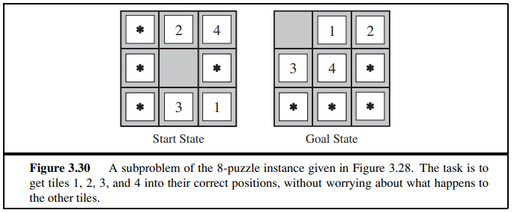
Generating admissible heuristics from subproblems: Pattern databases
Admissible heuristics can also be derived from the solution cost of a subproblem of a given problem.

Slide 8
The subproblem involves getting tiles 1, 2, 3, 4 into their correct positions. Clearly, the cost of the optimal solution of this subproblem is a lower bound on the cost of the complete problem.
One might wonder whether the heuristics obtained from the 1-2-3-4 database and the 5-6-7-8 could be added, since the two subproblems seem not to overlap. Would this still give an admissible heuristic?
The answer is no, because the solutions of the 1-2-3-4 subproblem and the 5-6-7-8 subproblem for a given state will almost certainly share some moves—it is unlikely that 1-2-3-4 can be moved into place without touching 5-6-7-8, and vice versa.
we record not the total cost of solving the 1-2- 3-4 subproblem, but just the number of moves involving 1-2-3-4.

Slide 9
Learning heuristics from experience
“Experience” here means solving lots of 8-puzzles, for instance. Each optimal solution to an 8-puzzle problem provides examples from which h(n) can be learned.
From these examples, a learning algorithm can be used to construct a function h(n) that can predict solution costs for other states that arise during search.
h(n) = c1x1(n) + c2x2(n)
The constants c1 and c2 are adjusted to give the best fit to the actual data on solution costs.

Slide 10
LOCAL SEARCH ALGORITHMS AND OPTIMIZATION PROBLEMS
When a goal is found, the path to that goal also constitutes a solution to the problem. In many problems, however, the path to the goal is irrelevant.
For example, in the 8-queens problem, what matters is the final configuration of queens, not the order in which they are added.
The same general property holds for many important applications such as integrated-circuit design, factory-floor layout, job-shop scheduling, automatic programming, telecommunications network optimization, vehicle routing, and portfolio management.

Slide 11
LOCAL SEARCH ALGORITHMS
In addition to finding goals, local search algorithms are useful for solving pure optimization problems, in which the aim is to find the best state according to an objective function.
Hill-climbing search
Simulated annealing
Local beam search
Genetic algorithms

Slide 12
Hill-climbing search
It is simply a loop that continually moves in the direction of increasing value—that is, uphill.
It terminates when it reaches a “peak” where no neighbor has a higher value.
The algorithm does not maintain a search tree, so the data structure for the current node need only record the state and the value of the objective function.
Hill climbing does not look ahead beyond the immediate neighbors of the current state.
Hill climbing is sometimes called greedy local search because it grabs a good neighbor state without thinking ahead about where to go next.

Slide 13
Hill climbing often gets stuck for the following reasons:
Local maxima: a local maximum is a peak that is higher than each of its neighboring states but lower than the global maximum. Solution:Backtracking
Ridges: Ridges result in a sequence of local maxima that is very difficult for greedy algorithms to navigate. Solution: Ridge can be solved by moving in several directions at same time
Plateau: a plateau is a flat area of the state-space landscape. It can be a flat local maximum, from which no uphill exit exists. Solution: plateau can be solved by making a high jump which will land in non plateau region.

Slide 14
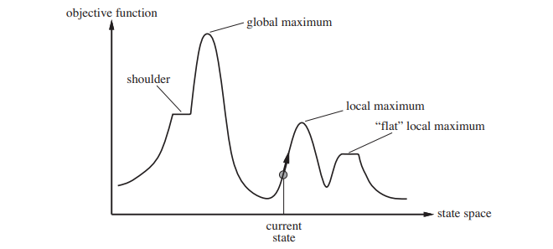

Slide 15
Types of Hill Climbing
1. Simple Hill Climbing Algorithm: Simple Hill Climbing is a straightforward variant of hill climbing where the algorithm evaluates each neighbouring node one by one and selects the first node that offers an improvement over the current one.
2. Steepest-Ascent Hill Climbing: Steepest-Ascent Hill Climbing is an enhanced version of simple hill climbing. Instead of moving to the first neighboring node that improves the state, it evaluates all neighbors and moves to the one offering the highest improvement (steepest ascent).
3.Stochastic Hill Climbing: Stochastic Hill Climbing introduces randomness into the search process. Instead of evaluating all neighbors or selecting the first improvement, it selects a random neighboring node and decides whether to move based on its improvement over the current state.

Slide 16
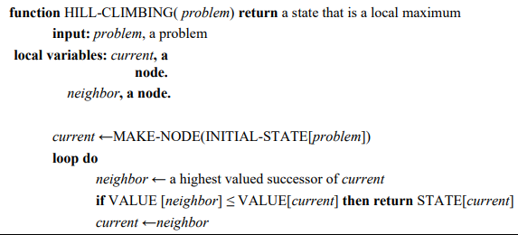

Slide 17
Simulated annealing
Simulated annealing is a probabilistic algorithm which tests points across a solution space to find the lowest minima.
The algorithm is termed “simulated annealing” because it mirrors physical annealing, a process in which a material is repeatedly heated and cooled to elicit desired structural properties.
Simulated annealing was first used extensively to solve VLSI layout problems in the early 1980s.
It has been applied widely to factory scheduling and other large-scale optimization tasks.

Slide 18
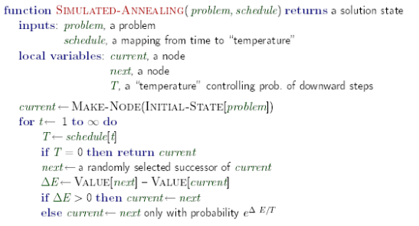

Slide 19
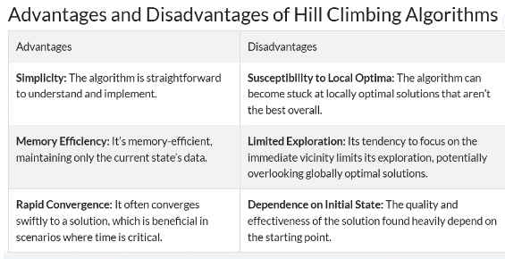

Slide 20
Local beam search
Keeping just one node in memory might seem to be an extreme reaction to the problem of memory limitations. The local beam search algorithm keeps track of k states rather than just one.
It begins with k randomly generated states. At each step, all the successors of all k states are generated. If any one is a goal, the algorithm halts. Otherwise, it selects the k best successors from the complete list and repeats.
A variant called stochastic beam search, instead of choosing the best k from the the pool of candidate successors, stochastic beam search chooses k successors at random.

Slide 21
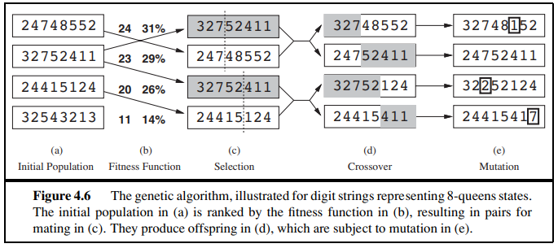
Genetic algorithms
A genetic algorithm, in which successor states are generated by combining two parent states rather than by modifying a single state.

Slide 22
GAs begin with a set of k randomly generated states, called the population. Each state, or individual, is represented as a string over a finite alphabet—most commonly, a string of 0s and 1s.
The production of the next generation of states is rated by the objective function, or the fitness function.
For each pair to be mated, a crossover point is chosen randomly from the positions in the string.
Finally, each location is subject to random mutation with a small independent probability.

Slide 23
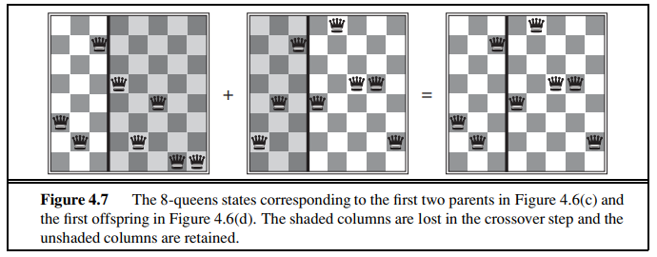

Slide 24
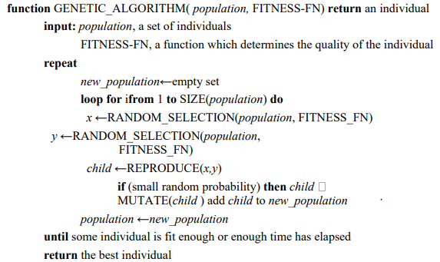

Slide 25
Constraint Satisfaction Problems
A Constraint Satisfaction Problem(or CSP) is defined by a set of variables,X1,X2,….Xn, and a set of constraints C1,C2,…,Cm.
Each variable Xi has a nonempty domain D,of possible values. Each constraint Ci involves some subset of variables and specifies the allowable combinations of values for that subset.
A State of the problem is defined by an assignment of values to some or all of the variables,{Xi = vi,Xj = vj,…}.
An assignment that does not violate any constraints is called a consistent or legal assignment. A complete assignment is one in which every variable is mentioned, and a solution to a CSP is a complete assignment that satisfies all the constraints.

Slide 26
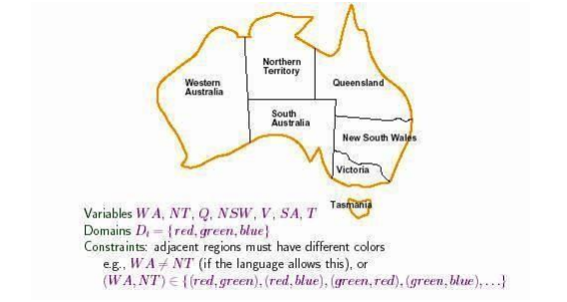
Constraint Satisfaction Problems
The map of Australia showing each of its states and territories. We are given the task of coloring each region either red, green, or blue in such a way that the neighboring regions have the same color. To formulate this as CSP, we define the variable to be the regions
Solve the following map coloring problem using Constraint Satisfaction problem with Domain = {red, blue, green}

Slide 27
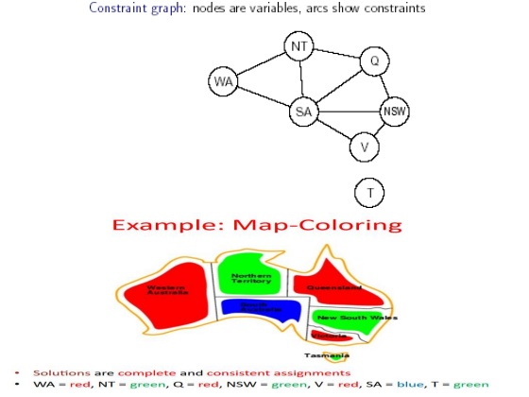

Slide 28
Constraint Satisfaction Problems
CSP can be viewed as a standard search problem as follows:
➢ Initial state: the empty assignment {},in which all variables are unassigned.
➢ Successor function: a value can be assigned to any unassigned variable, provided that it does not conflict with previously assigned variables.
➢ Goal test: the current assignment is complete.
➢ Path cost: a constant cost(E.g.,1) for every step.
Every solution must be a complete assignment and therefore appears at depth n if there are n variables. Depth first search algorithms are popular for CSPs

Slide 29
Constraint Satisfaction Problems
Varieties of CSPs
Discrete variables Finite domains -The simplest kind of CSP involves variables that are discrete and have finite domains. Map coloring problems are of this kind. The 8-queens problem can also be viewed as finitedomain CSP, where the variables Q1,Q2,…..Q8 are the positions each queen in columns 1,….8 and each variable has the domain {1,2,3,4,5,6,7,8}.
Discrete variables can also have infinite domains – for example, the set of integers or the set of strings. With infinite domains, it is no longer possible to describe constraints by enumerating all allowed combination of values.
CSPs with continuous domains CSPs with continuous domains are very common in real world

Slide 30

Varieties of constraints
unary constraints involve a single variable. Example : SA # green
Binary constraints involve paris of variables. Example : SA # WA
Higher order constraints involve 3 or more variables. Example :cryptarithmetic puzzles.
Solve the following crypt arithmetic puzzle using Constraint Satisfaction problem with Domain = {0,1,2,3,4,5,6,7,8,9}

Slide 31
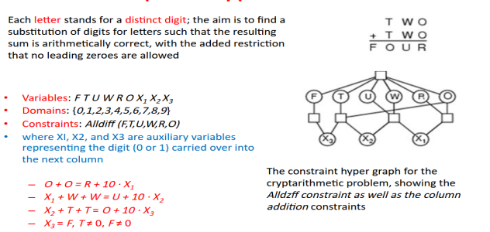
CSP Eg. cryptarithmetic puzzles.

Slide 32
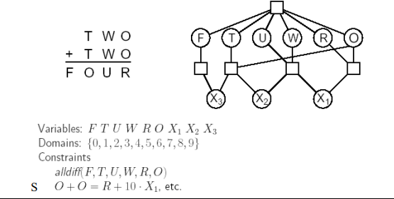

Slide 33
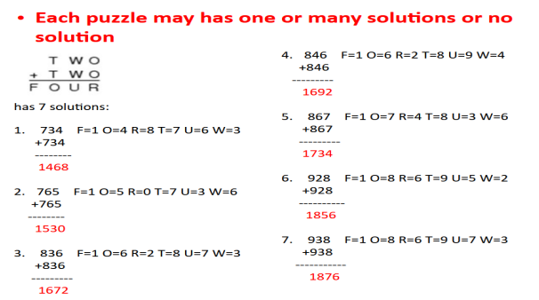

Slide 34
Adversarial Search
Adversarial search is a search, where we examine the problem which arises when we try to plan ahead of the world and other agents are planning against us.
In previous topics, we have studied the search strategies which are only associated with a single agent that aims to find the solution which often expressed in the form of a sequence of actions.
But, there might be some situations where more than one agent is searching for the solution in the same search space, and this situation usually occurs in game playing.

Slide 35
The environment with more than one agent is termed as multi-agent environment, in which each agent is an opponent of other agent and playing against each other. Each agent needs to consider the action of other agent and effect of that action on their performance.
So, Searches in which two or more players with conflicting goals are trying to explore the same search space for the solution, are called adversarial searches, often known as Games.
The Minimax Algorithm
Alpha-Beta Pruning

Slide 36
A game can be defined as a type of search in AI which can be formalized of the following elements:
Initial state: It specifies how the game is set up at the start.
Player(s): It specifies which player has moved in the state space.
Action(s): It returns the set of legal moves in state space.
Result(s, a): It is the transition model, which specifies the result of moves in the state space.
Terminal-Test(s): Terminal test is true if the game is over, else it is false at any case. The state where the game ends is called terminal states.
Utility(s, p): A utility function gives the final numeric value for a game that ends in terminal states s for player p. It is also called payoff function. For Chess, the outcomes are a win, loss, or draw and its payoff values are +1, 0, ½. And for tic-tac-toe, utility values are +1, -1, and 0.

Slide 37
Games vs. search problems
"Unpredictable" opponent → specifying a move for every possible opponent reply Time limits → unlikely to find goal, must approximate

Slide 38
Game search
Game-playing programs developed by AI researchers since the beginning of the modern AI era
Programs playing chess, checkers, etc (1950s)
Specifics:
Sequences of player’s decisions we control
Decisions of other player(s) we do not control
Contingency problem: many possible opponent’s moves must be “covered” by the solution
Opponent’s behavior introduces uncertainty
Rational opponent – maximizes its own utility (payoff) function

Slide 39
Game Search Problem
Problem formulation
Initial state: initial board position + whose move it is
Operators: legal moves a player can make
Goal (terminal test): game over?
Utility (payoff) function: measures the outcome of the game and its desirability
Search objective:
Find the sequence of player’s decisions (moves) maximizing its utility (payoff)
Consider the opponent’s moves and their utility

Slide 40
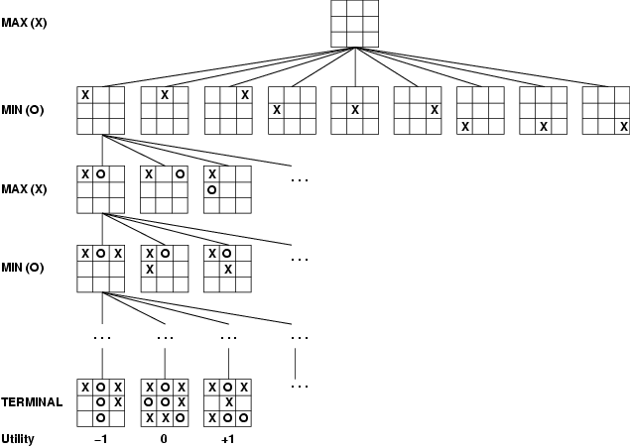
Game tree (2-player, deterministic, turns)

Slide 41
Minimax Algorithm
How to deal with the contingency problem?
Assuming the opponent is always rational and always optimizes its behavior (opposite to us), we consider the best opponent’s response
Then the minimax algorithm determines the best move

Slide 42
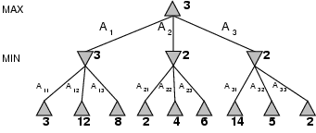
Minimax
Perfect play for deterministic games
Idea: choose move to position with highest minimax value = best achievable payoff against best play
E.g., 2-ply game: [will go through another eg in lecture]

Slide 43
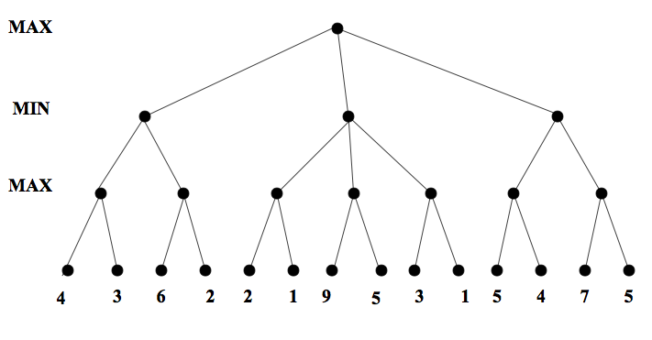
Minimax. Example

Slide 44
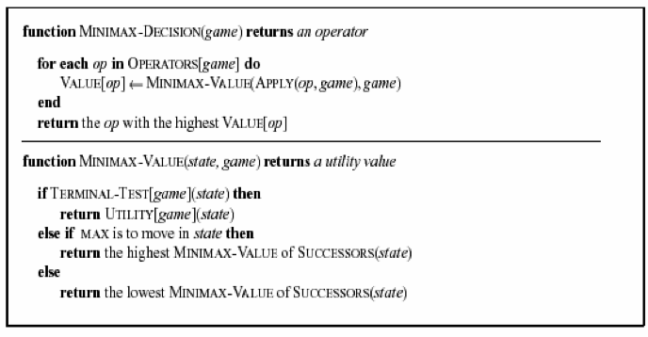

Slide 45
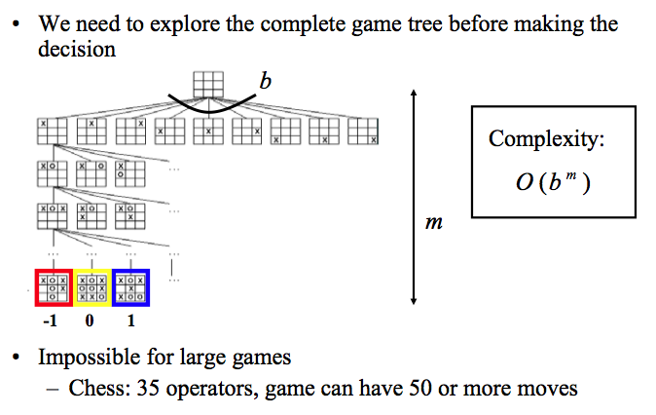
Complexity of the minimax algorithm

Slide 46
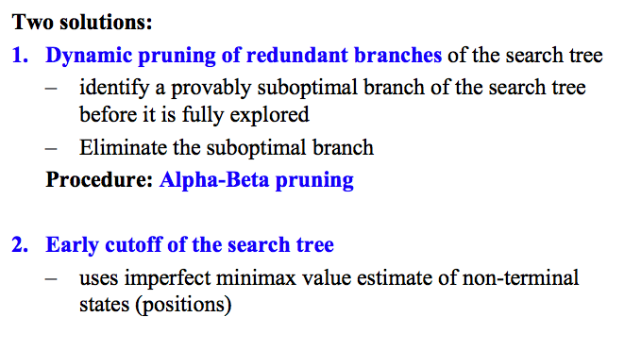
Solution to the complexity problem

Slide 47
Alpha Beta Pruning
Some branches will never be played by rational players since they include sub-optimal decisions for either player
First, we will see the idea of Alpha Beta Pruning
Then, we’ll introduce the algorithm for minimax with alpha beta pruning, and go through the example again, showing the book-keeping it does as it goes along

Slide 48
Alpha beta pruning. Example

Slide 49
Minimax with alpha-beta pruning: The algorithm
Maxv: function called for max nodes
Might update alpha, the best max can do far
Minv: function called for min nodes
Might update beta, the best min can do so far
Each tests for the appropriate pruning case
We’ll go through the algorithm on the course website

Slide 50
Algorithm example: alphas/betas shown

Slide 51
Properties of α-β
Pruning does not affect final result
Good move ordering improves effectiveness of pruning
With "perfect ordering," time complexity = O(b^{m/2})
→ doubles depth of search
A simple example of the value of reasoning about which computations are relevant (a form of metareasoning)

Slide 52
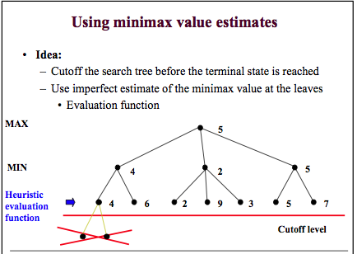

Slide 53
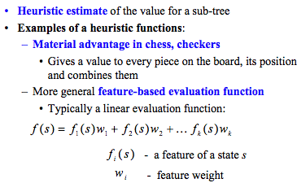
Design of evaluation functions

Slide 54
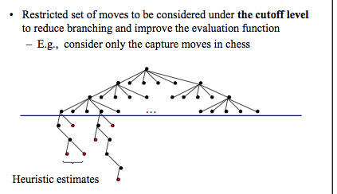
Further extensions to real games

